Slide 1
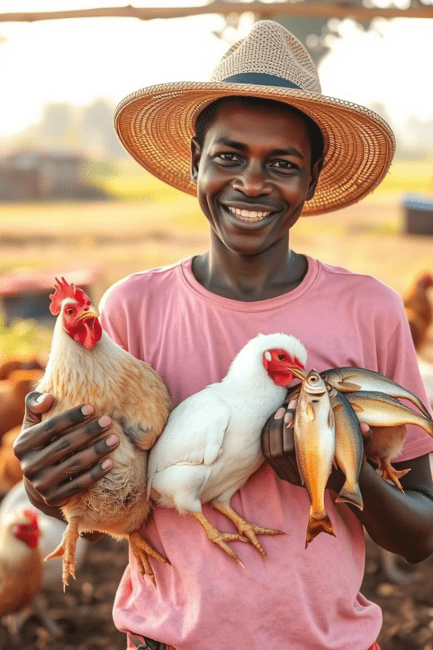
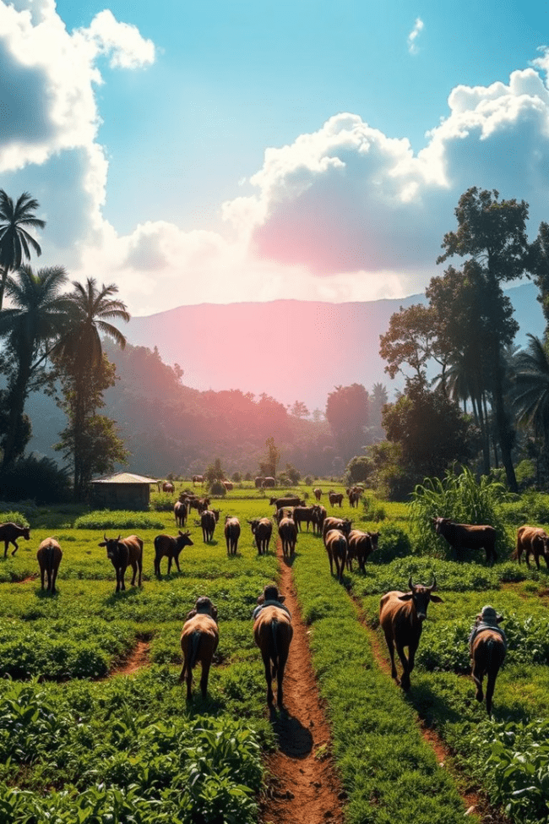
AGRITECH FEEDS
MASTER SOLUTIONS
Addressing feeds affordability and environmental challenges
in Northern Uganda
BY COTN MARANI HONORS HIGH SCHOOL LIRA
eN

Slide 2
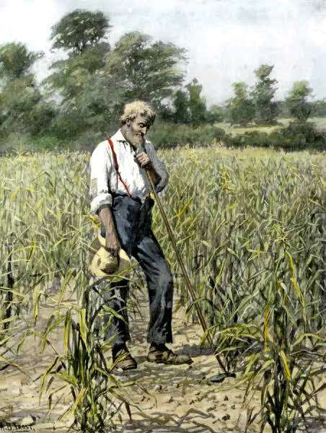
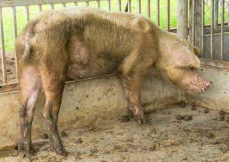
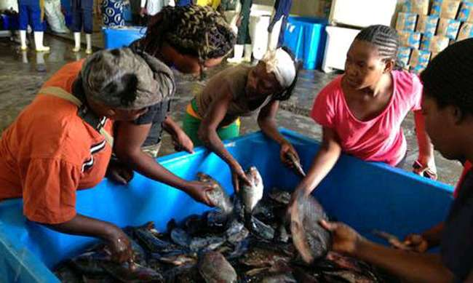
DID YOU KNOW THAT?
80% OF NORTHERN UGANDA FARMERS LACK AFFORDABLE PROTEIN FEEDS AND CONCENTRATES!

Slide 3
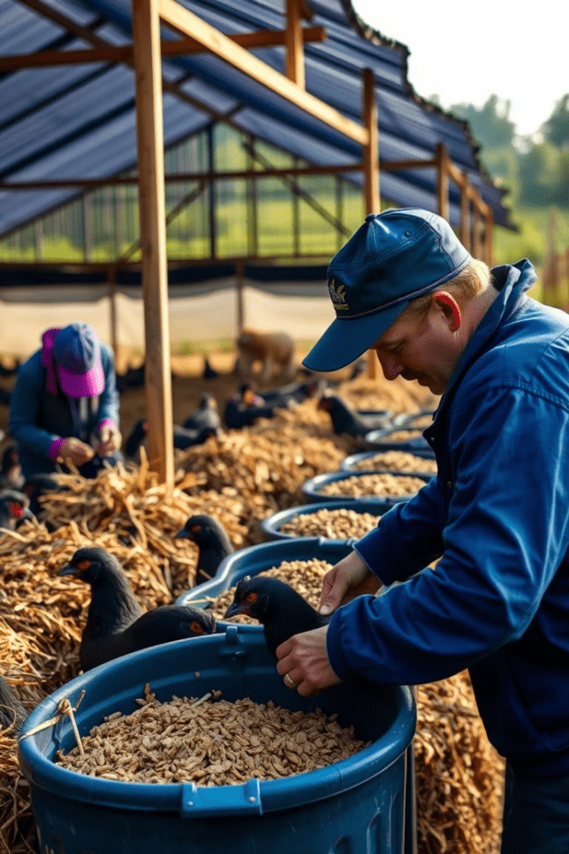
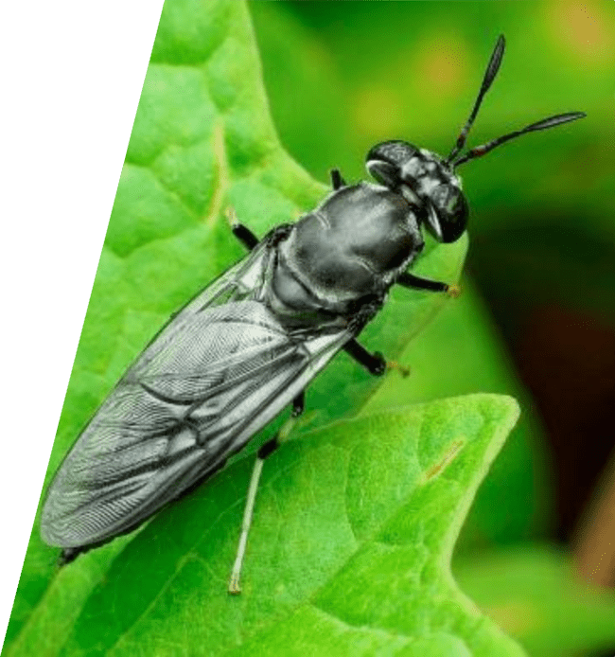
The Problem or Need among farmers
Local Plant Feeds
LIMITED ACCESSTO PROTEIN
FEEDS AND CONCENTRATE ACCESS
Seasonal, lack essential nutrients
Imported Concentrates
Costly, supply chain issues
Slow, insufficient protein source
80% of Northern Uganda farmers lack affordable protein feeds and concentrates
YET-Imported feeds expensive due to high poverty rate, global disruptions like wars, among others.
Environmental Impact
Traditional Composting
Waste emits greenhouse gases harming climate

Slide 4
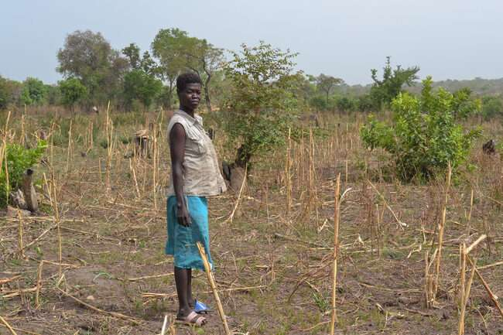



Slide 5
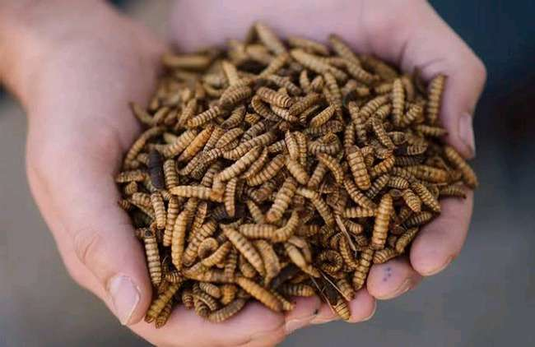
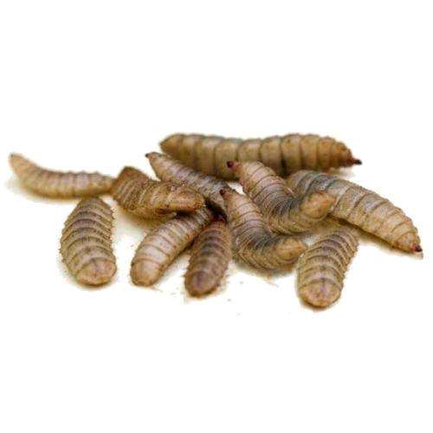
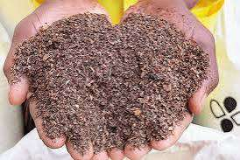

Our Innovative Solution
We do BSF Farming
Out of BSF we produce
Larvae convert organic waste to protein-rich biomass
Dry Worms concentrates
Fresh warm concentrates
Frass fertilizer
Dry Worm’s oil supplement
High Protein- Larvae contain 40% protein,
10% fat at pupa stage
30kg larvae produced daily at campus farm

Slide 6
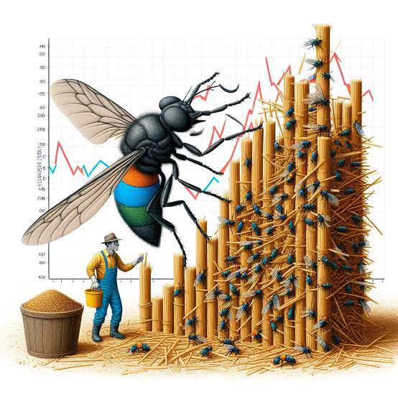
Implementation & Operation
1
Feedstock
Organic waste from school and markets, zero cost
2
Adult Flies
Require only water, no digestion
3
Daily Production
15kg dry larvae
5kg fresh larvae
5kg frass
4 liters oil
4
Pricing
Dry: 15,000 UGX/kg, Fresh: 12,000 UGX/kg, Frass: 7,000 UGX/kg, Oil: 20,000 UGX/liter

Slide 7
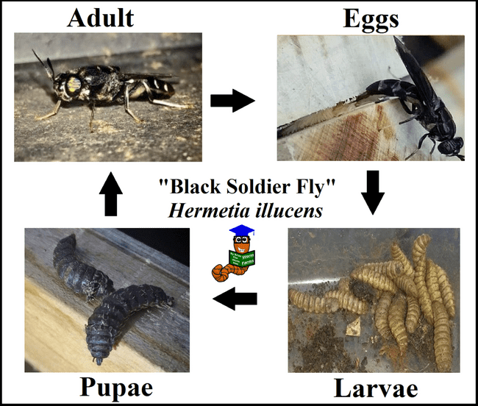
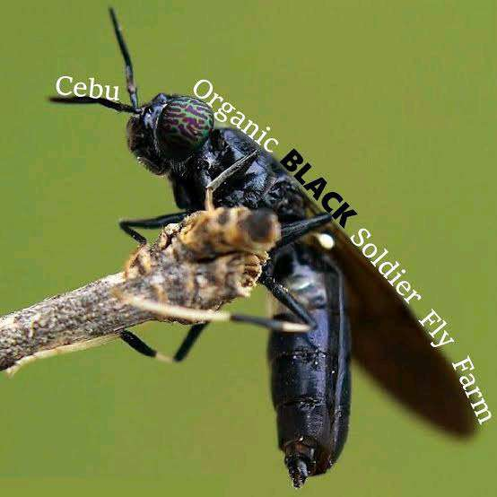

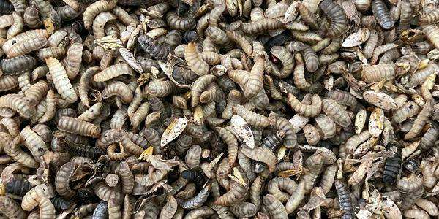
OPERATION & PRODUCTION COSTS BREAK DOWN
Product
Daily Production
Unit Cost (UGX)
Selling Price (UGX)
Dry Worms
15 Kg
5,000
15,000/kg
Fresh Worms
5 Kg
5,000
12,000/kg
Frass
5 Kg
3,000
7,000/kg
Oil
1 Liters
9,000
20,000/liter

Slide 8
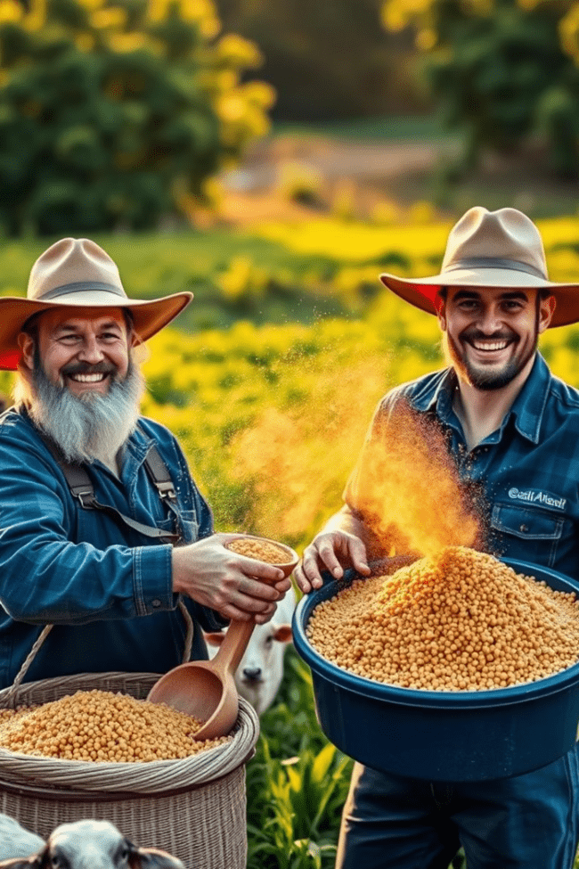
Benefits & Impact
Environmental
Economic
Reduces greenhouse gas emissions
Affordable, quality feed boosts productivity
Social
Creates jobs, promotes sustainability

Slide 9
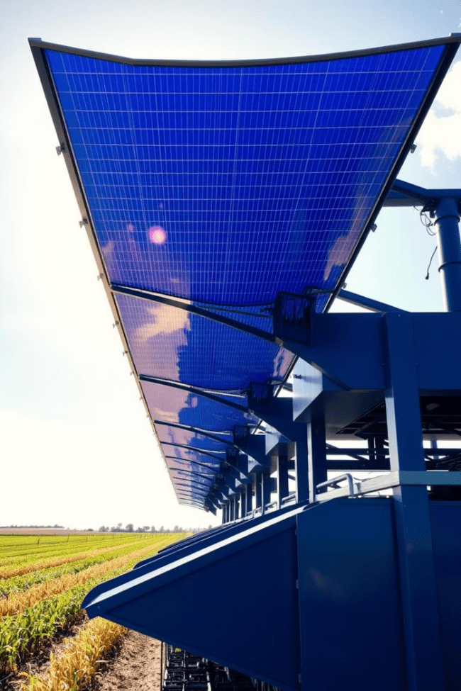



Future Plans
Expand Production
Meet growing demand
Innovate
Invest in solar dryer technology
Outreach
Serve more districts even far and beyond

Slide 10

Conclusion & Call to Action
Sustainable Agriculture
Transforming waste into wealth
Environmental Conservation
Protecting our planet
Economic Empowerment
Empowering farmers and communities
Join Us
Support a greener and a prosperous future

